Slide 1
Travel agent
CAPSTONE PROJECT
Presented By:
Student name : Siddivinayak Doppalapudi
Enroll.No: 23012531069
College Name : Ganpat University (UVPCE)
Department: CE(AI)

Slide 2
OUTLINE
Problem Statement
Technology used
Wow factor
End users
Result
Conclusion
Git-hub Link
Future scope
IBM Certifications

Slide 3
Problem Statement
In the current era of increasing health consciousness, individuals are actively seeking personalized nutrition guidance tailored to their unique lifestyles, preferences, and medical needs. However, most existing digital nutrition tools provide generalized diet plans that lack real-time adaptability and fail to consider critical factors such as cultural food habits, allergies, ongoing health conditions, and fitness goals. Additionally, dieticians and nutritionists face significant limitations in scaling personalized consultations due to time and resource constraints, resulting in a gap between demand and quality personalized nutrition services.

Slide 4
Technology used
IBM Cloud Watsonx Al Studio
IBM Cloud Watsonx Al runtime
IBM Cloud Agent Lab
IBM Granite foundation model
IBM Cloud Object Storage
IBM Cloud IAM (Identity and Access Management)

Slide 5
IBM cloud services used
IBM Cloud Watsonx AI Studio
IBM Cloud Watsonx AI runtime
IBM Cloud Agent Lab
IBM Granite foundation model

Slide 6
Wow factors
The Smartest AI Nutrition Assistant stands out with its innovative use of multimodal input, allowing users to interact through text making the experience seamless and intuitive. Unlike traditional diet apps, it offers real-time personalization by dynamically adjusting meal plans based on a user’s health conditions, goals, lifestyle, and cultural preferences. The system provides context-aware explanations for each recommendation, empowering users with clear insights into their nutritional choices.
One of the key differentiators is its ability to recognize allergies and medical conditions, ensuring that all suggestions are safe and medically appropriate. It also supports regional and culturally relevant meals, enhancing usability across diverse populations. The assistant is built using IBM Cloud Lite and IBM Granite models, ensuring enterprise-grade performance, scalability, and security.

Slide 7
End users
Health-Conscious Individuals
Patients with Medical Conditions
Fitness Enthusiasts & Athletes
Busy Professionals & Students

Slide 8
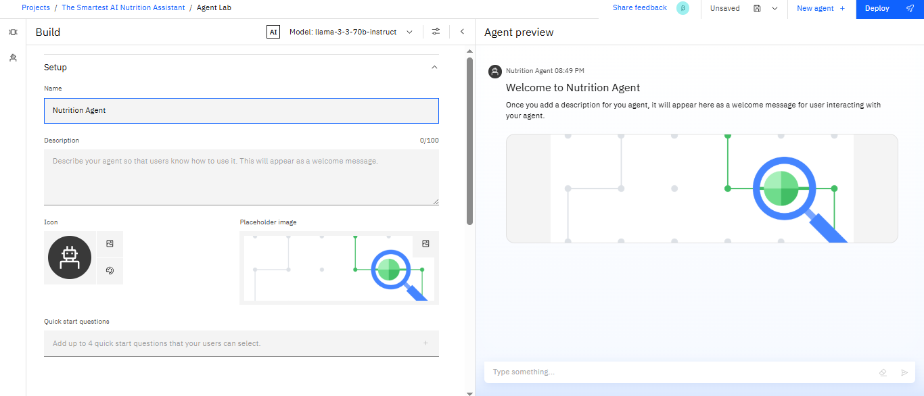
Results
SET UP:-

Slide 9
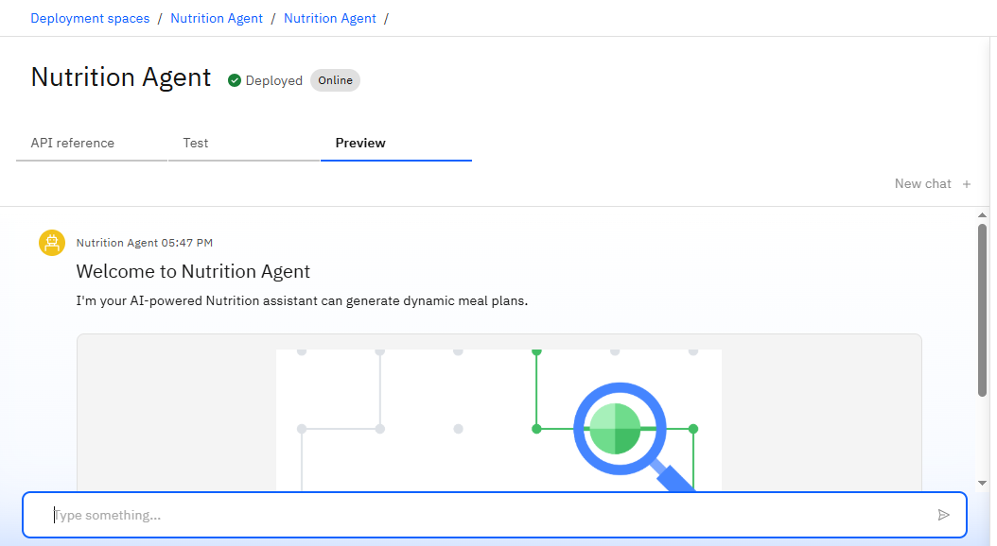
Results
AGENT PREVIEW:-

Slide 10
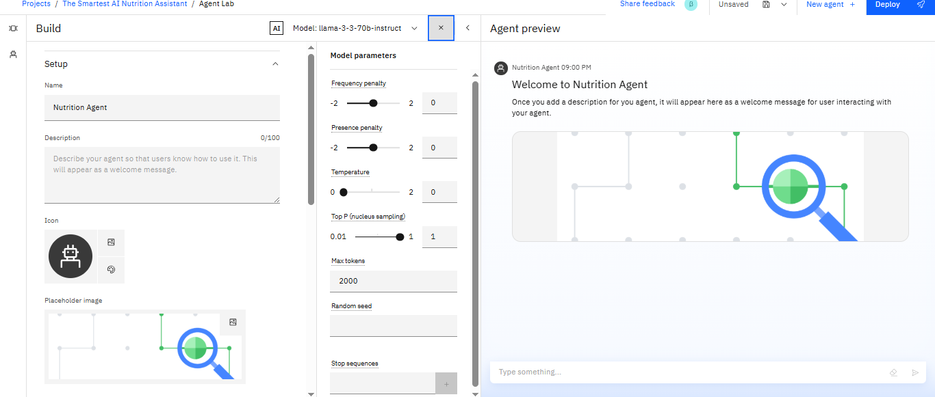
Results
MODEL PARAMATER:-

Slide 11
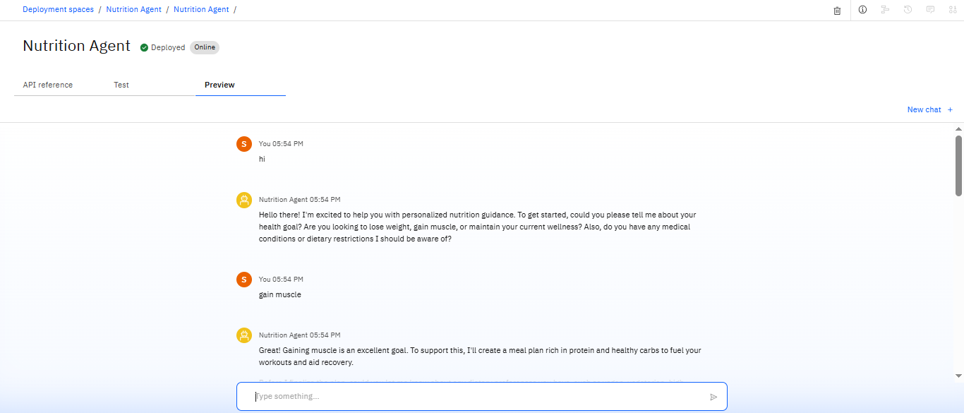
Results

Slide 12
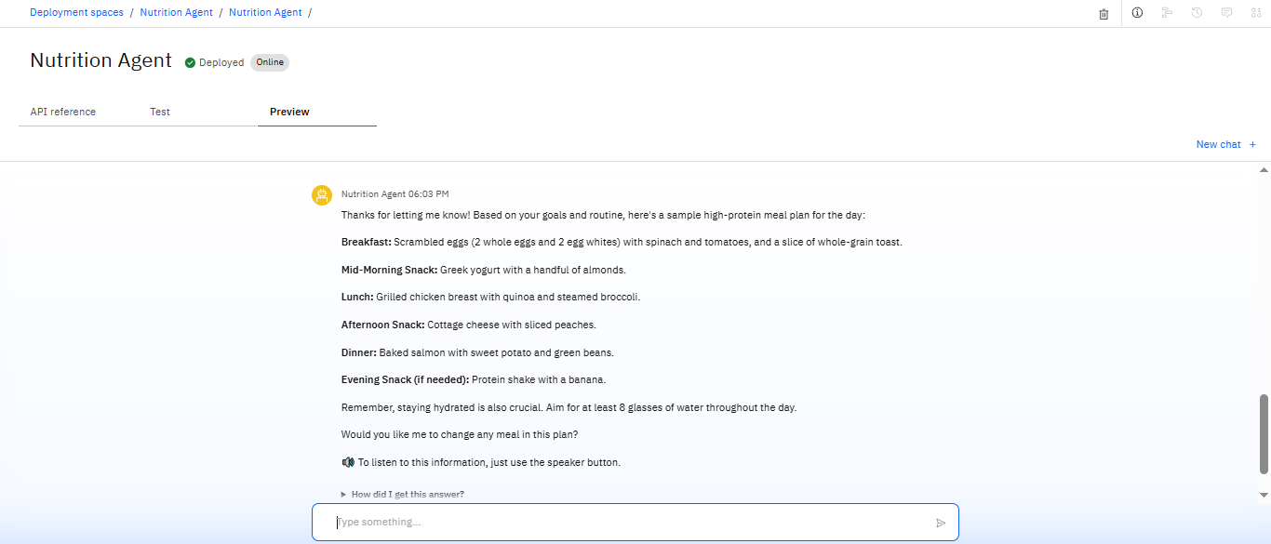
Results

Slide 13
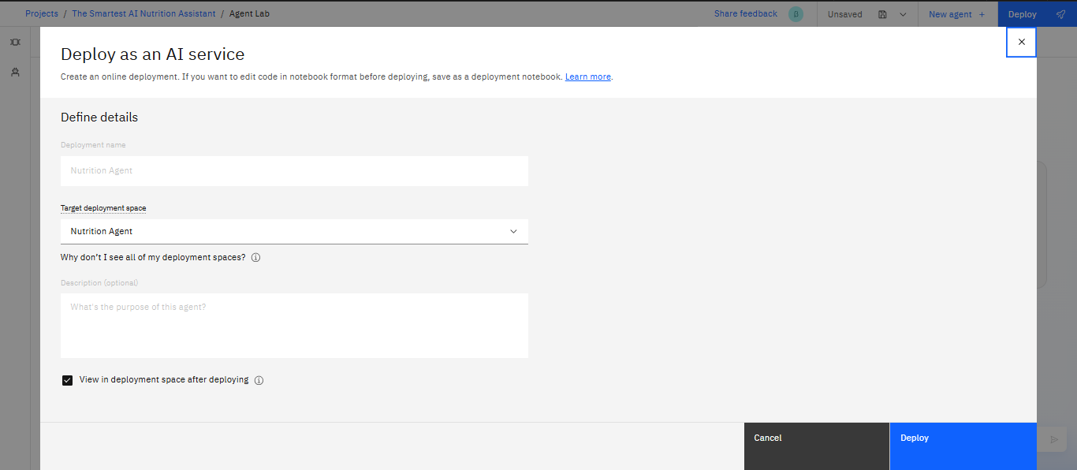
Results
AGENT DEPLOY:-

Slide 14
Conclusion
The Smartest AI Nutrition Assistant leverages the power of generative AI to redefine how individuals approach personalized health and nutrition. By integrating natural language processing, multimodal input understanding, and real-time adaptability, the system offers tailored dietary guidance that evolves with the user. Unlike static diet apps, this assistant provides context-aware recommendations, cultural sensitivity, and allergy-aware planning—bridging the gap between one-size-fits-all tools and expert nutrition counseling.
With the support of IBM Cloud Lite and IBM Granite models, the solution is both scalable and secure, making expert-level nutrition guidance accessible to all. As it learns from user interactions, it becomes increasingly intelligent, empathetic, and impactful—paving the way for a healthier and more informed future.

Slide 15
Future scope
The Smartest AI Nutrition Assistant holds immense potential for future development and expansion. Key areas for enhancement include:
Integration with Wearable Devices ➤ Sync with smartwatches and fitness trackers to adapt meal plans based on real-time health metrics (e.g., heart rate, activity, sleep).
Voice Assistant Integration ➤ Seamless integration with smart home devices like Alexa, Google Assistant for hands-free experience.
Offline & Low-Bandwidth Access ➤ Optimize the assistant for rural or low-connectivity environments using edge computing or cached data.

Slide 16
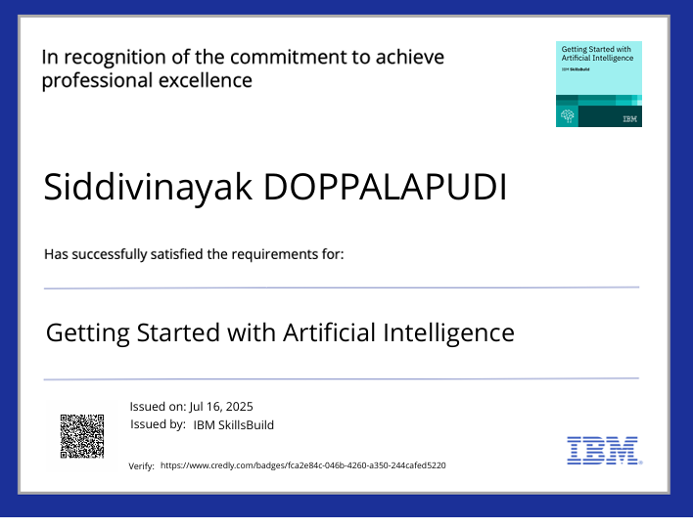
IBM Certifications

Slide 17
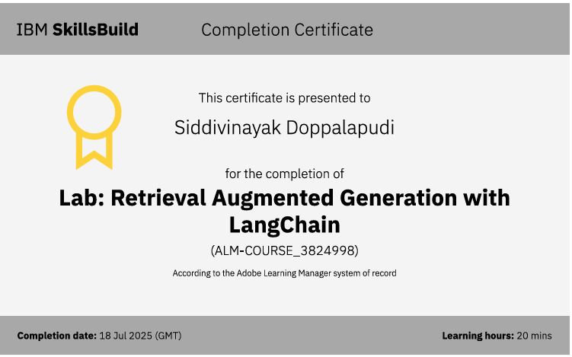
IBM Certifications

Slide 18
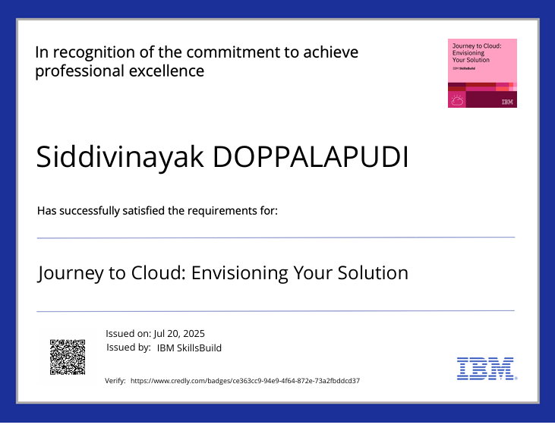
IBM Certifications

Slide 19
GitHub Link
Git hub link : https://github.com/DSV05/Nutrition-Agent/blob/main/Nutrition_Agent1.pptx

Slide 20
THANK YOU

